Slide 1
SPRING BOOT REST API
BY DHRUV DHOLARIYA

Slide 2
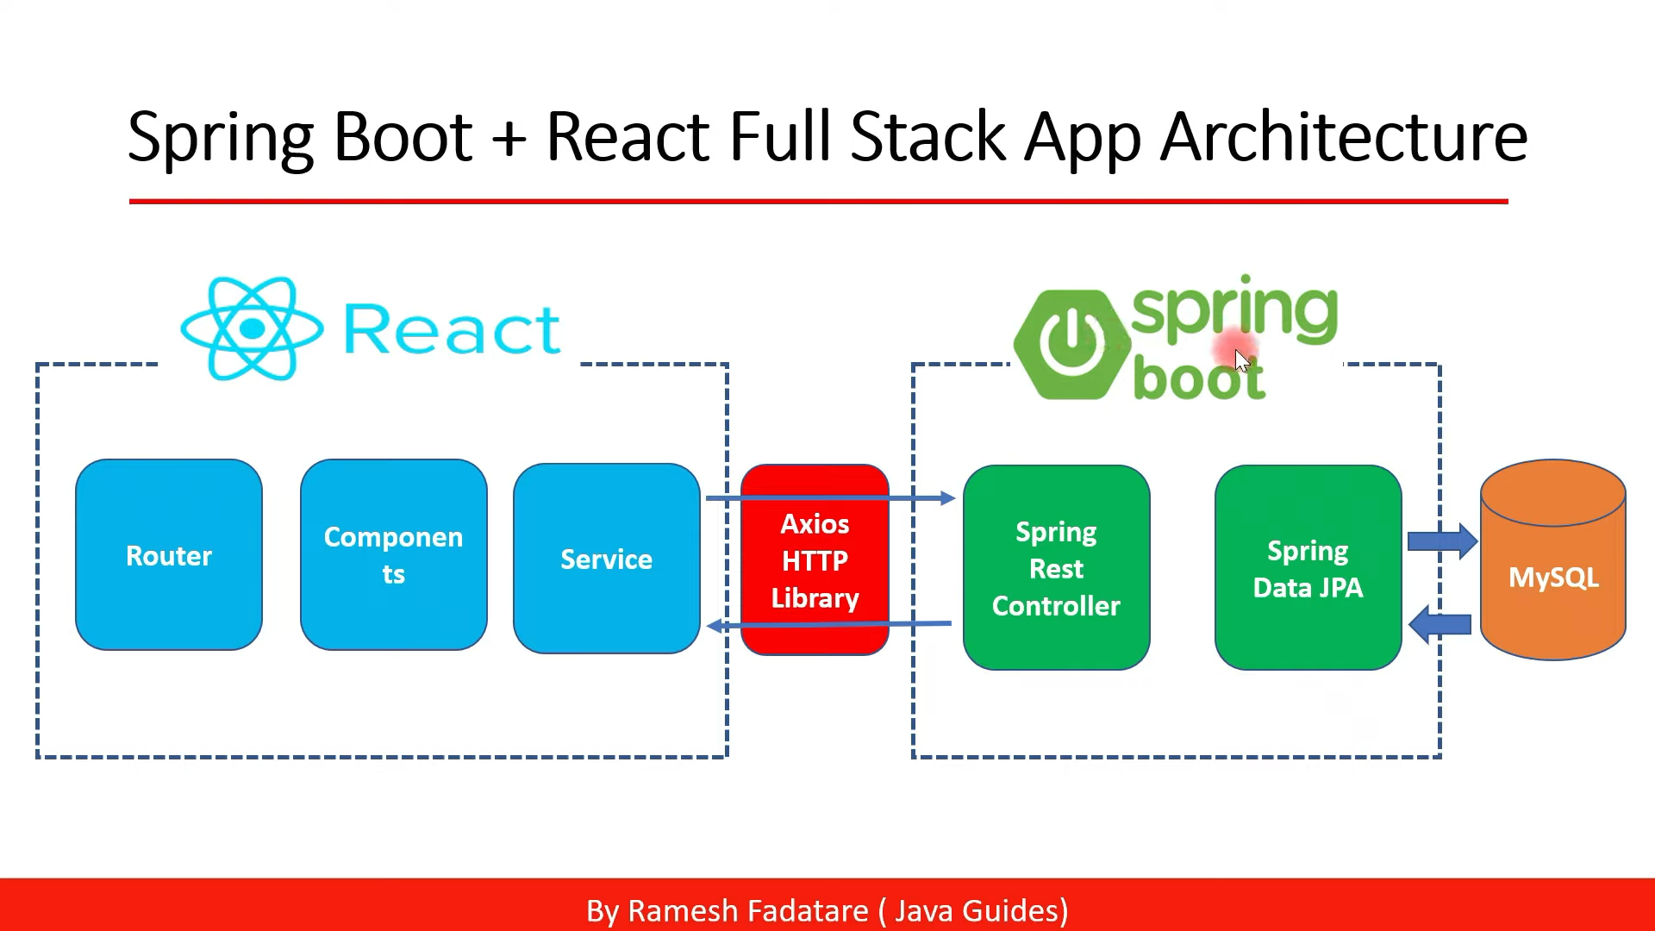

Slide 3
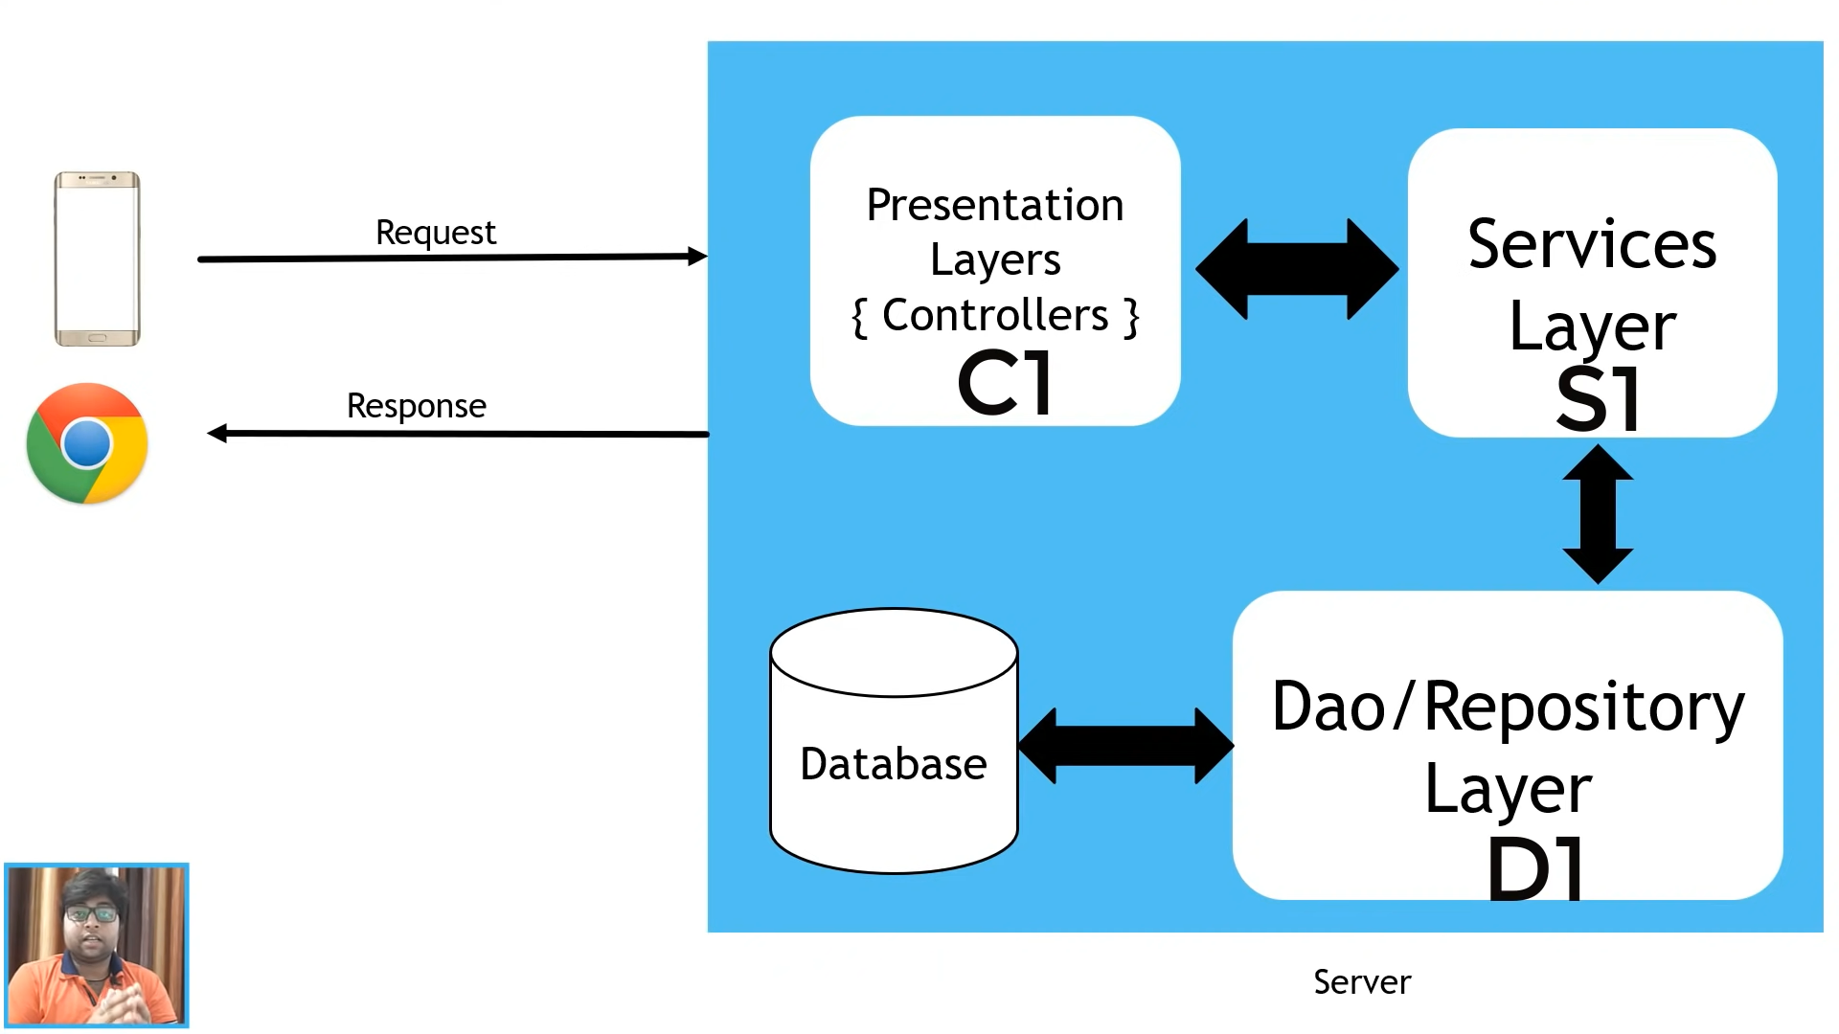
Controller accepts the requests
Controller will take help of service layer , it includes all class and methods
Service layer take help of Dao layer to access database
Controller accepts the requests
Controller will take help of service layer , it includes all class and methods
Service layer take help of Dao layer to access database

Slide 4
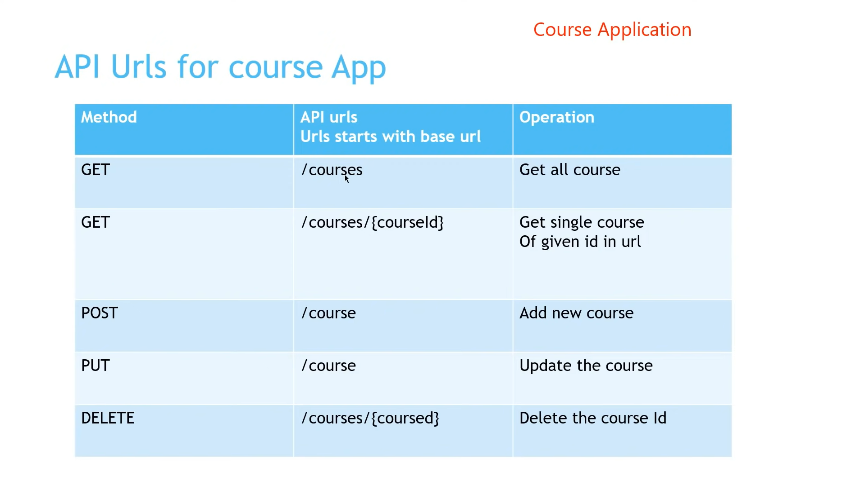

Slide 5
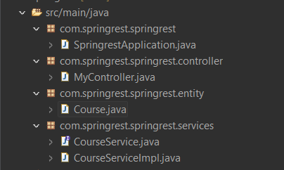
Folder structure

Slide 6
For get Request ==>

Slide 7
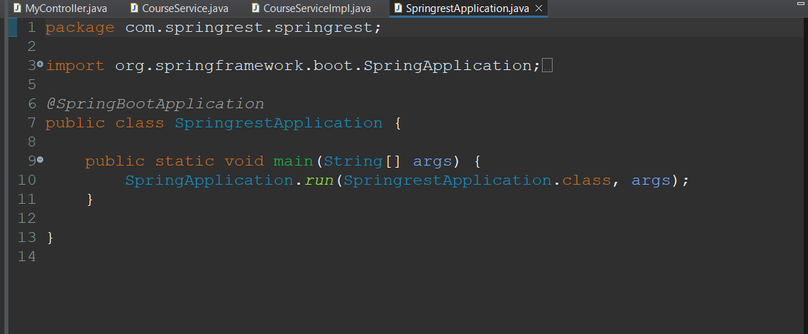

Slide 8
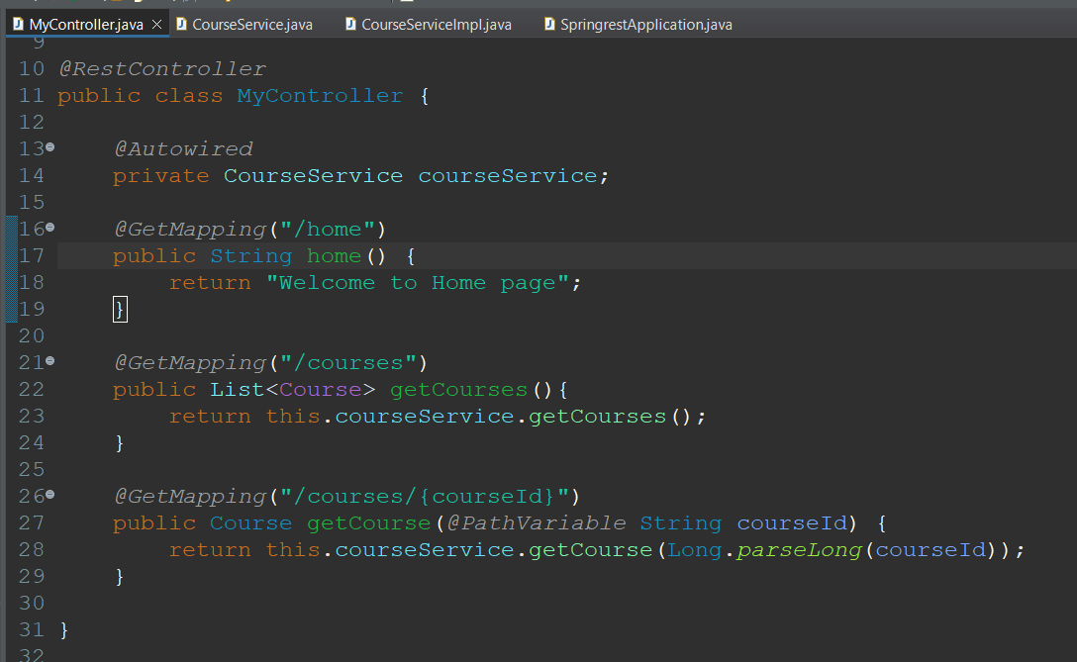

Slide 9
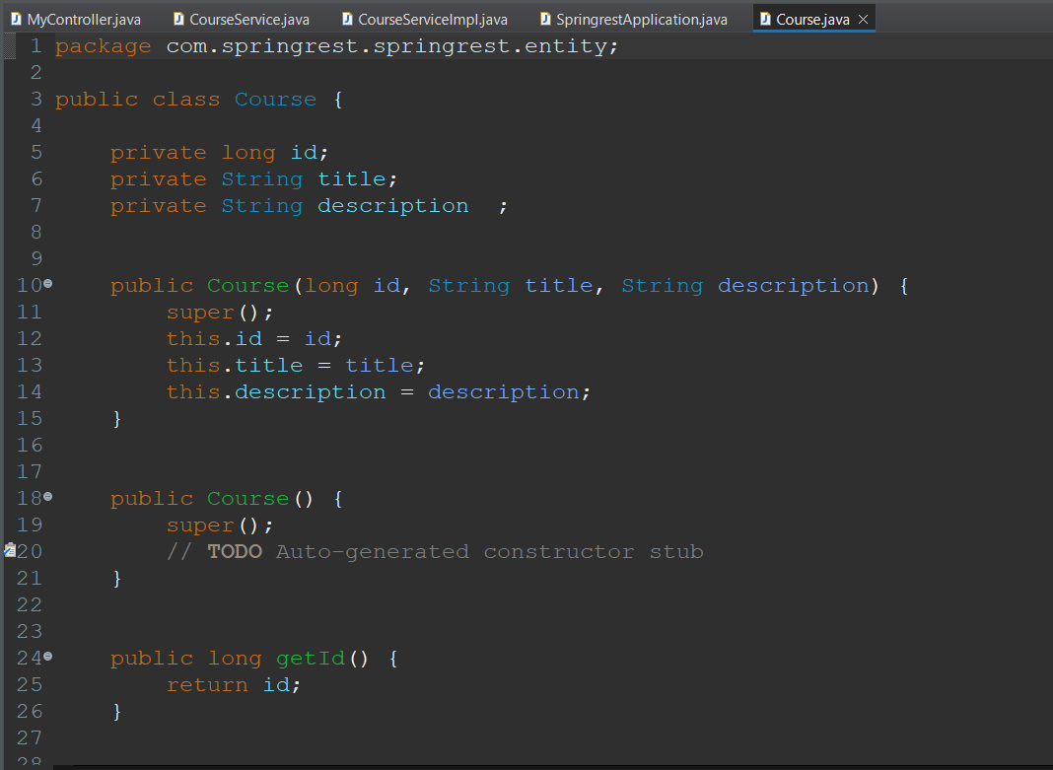
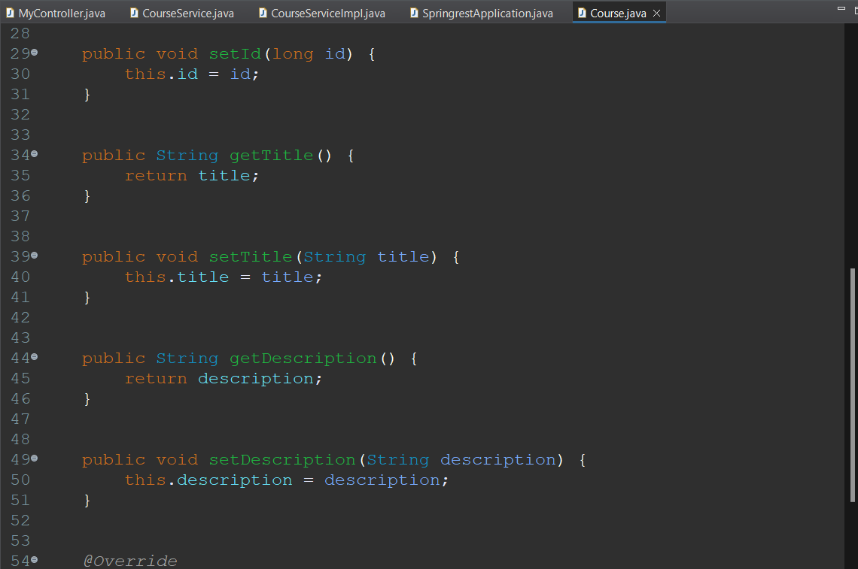

Slide 10
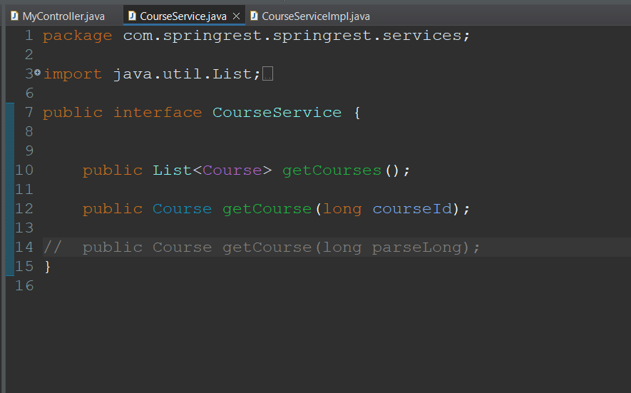

Slide 11
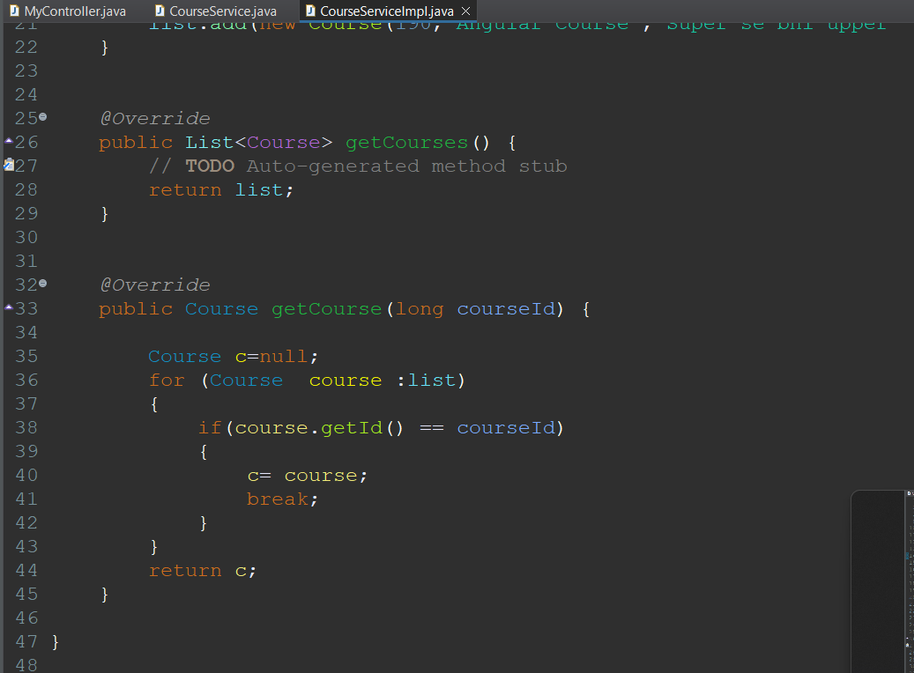
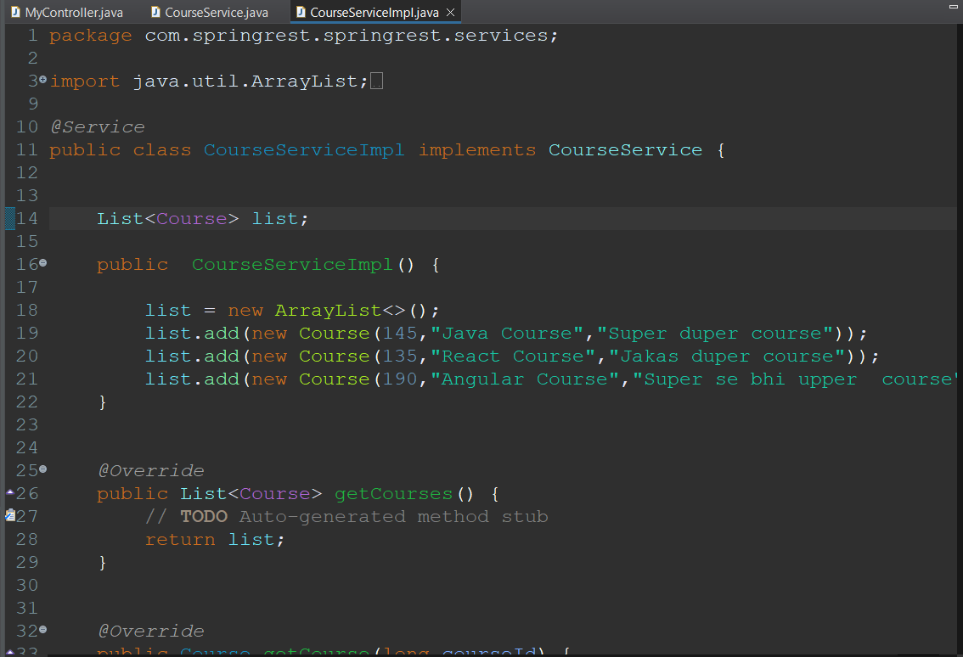

Slide 12
For POST REQUEST ➔

Slide 13
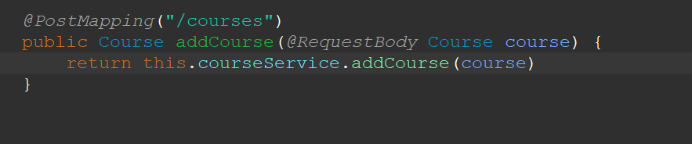
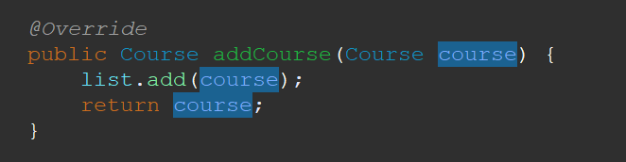

Slide 14
For PUT REQUEST ➔

Slide 15
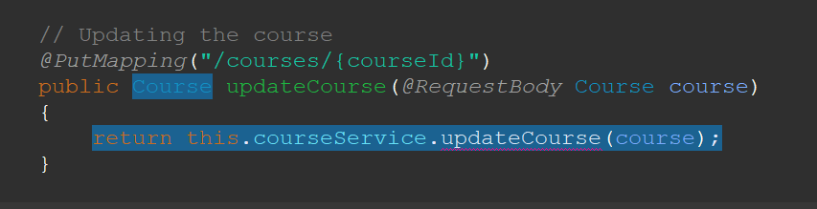

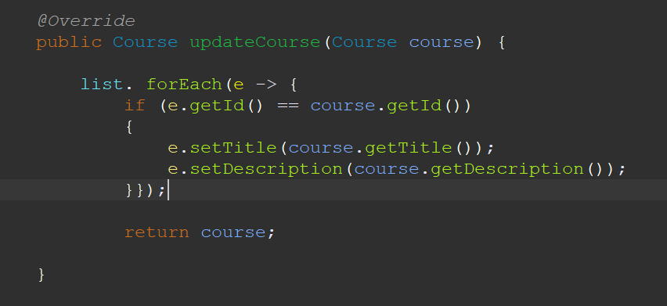

Slide 16
For Delete Request ➔

Slide 17
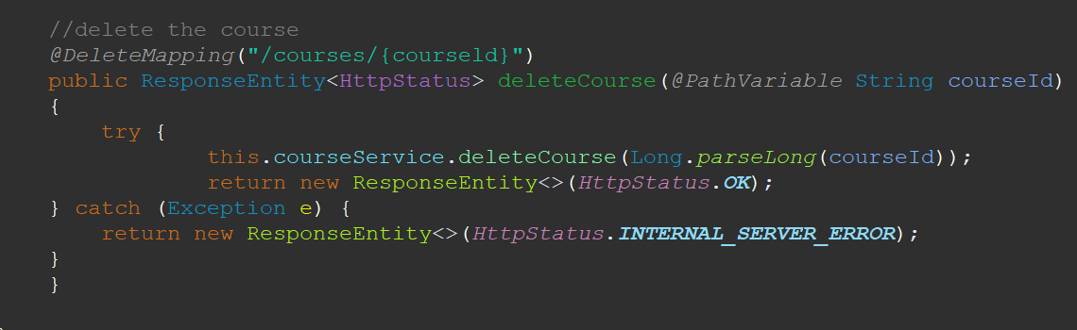
@Override public void deleteCourse(long parseLong) { list = this.list.stream().filter(e->e.getId()!=parseLong).collect(Collectors.toList()); }

